Slide 1
Lab NN and SVM
Dataset:
risk
datasets.xls NN and SVM
Algorithms:

Slide 2
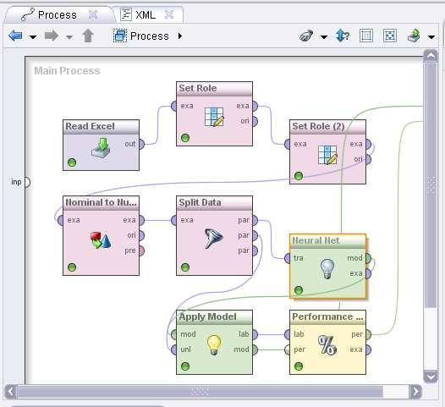
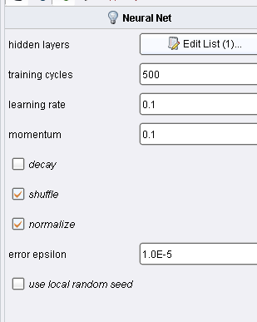
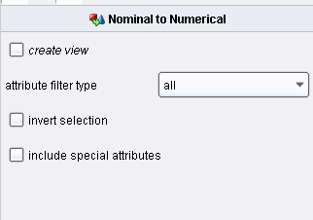

Slide 3
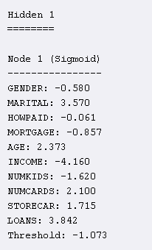
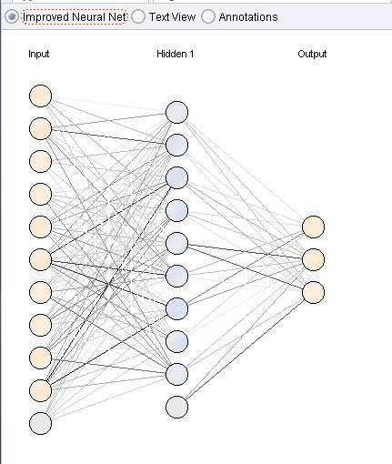
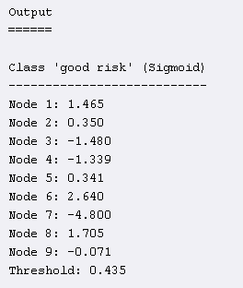

Slide 4
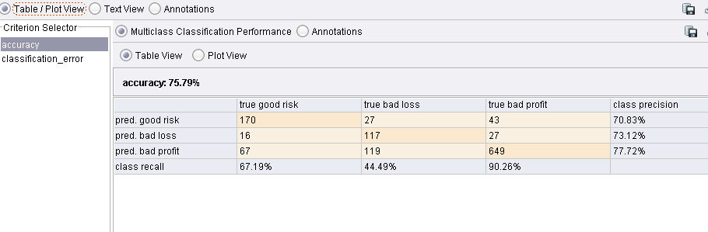
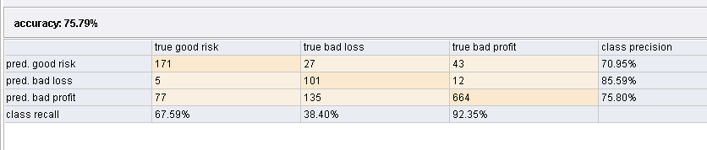
Neural Network
Decision Tree

Slide 5
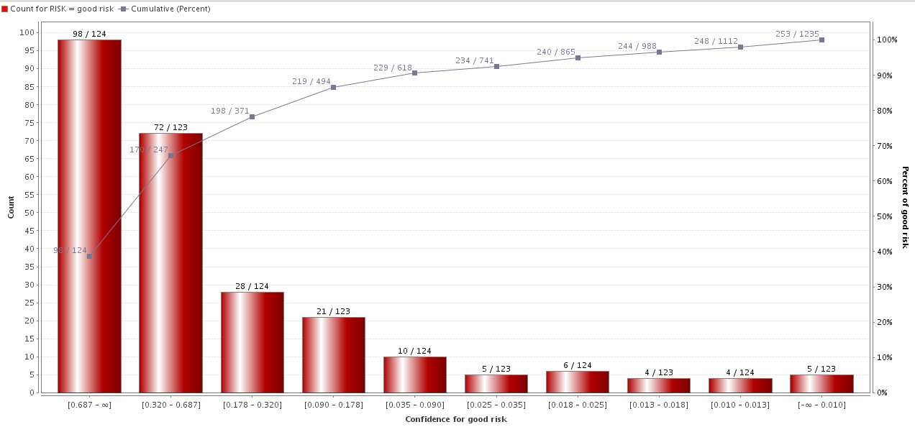
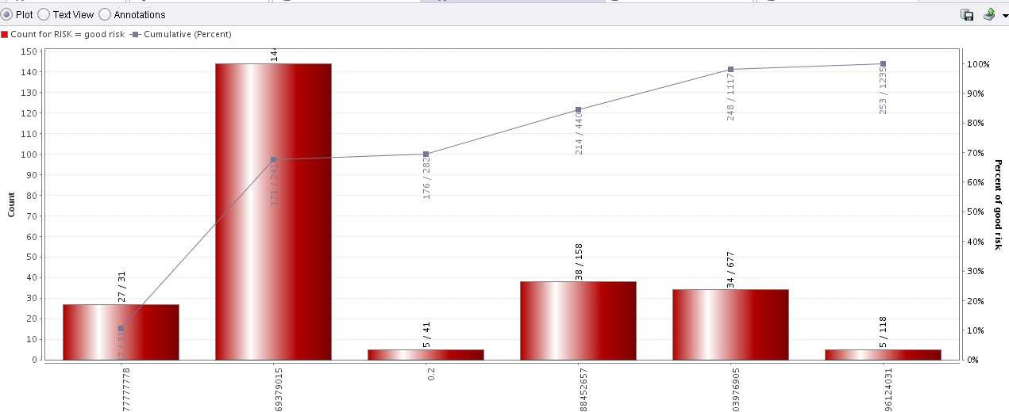
Neural Network
Decision Tree

Slide 6
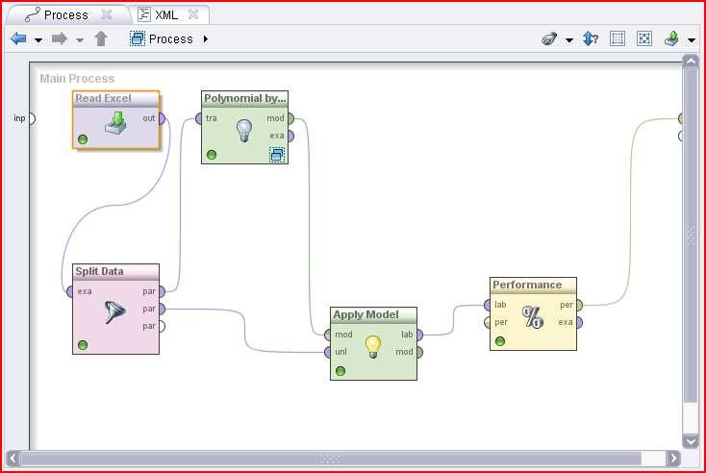
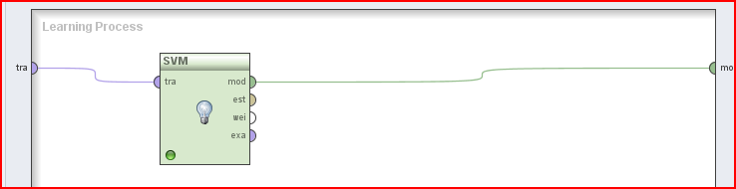
Taget variable of nominal type;
Use only the numerical input variables.
Support Vector Machines
Test different methods for polynomial classification using binary classifiers (OAO and OAA) Test different kernels (dot, radial and polynomial) and different parameters.

Slide 7
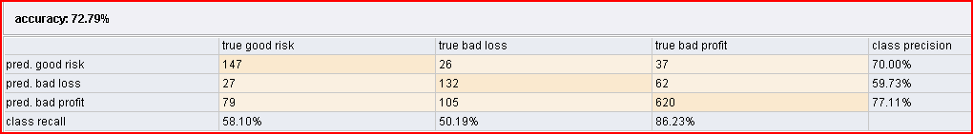
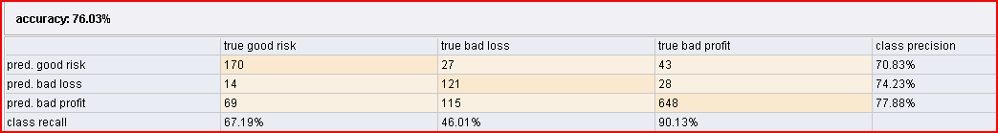
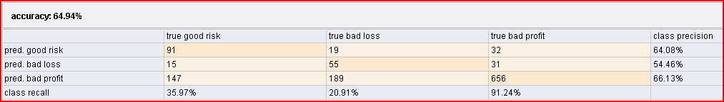
Support vector machines: linear (dot) kernel
Support vector machines: radial kernel
Support vector machines: polynomial kernel

